Slide 1

Vehicle Service Station Management
Portal
Presented By
Depe Bhavanjay Balaji & Dhananjay Sudhakar Khuje

Slide 2
Introduction
The increase of vehicles productions in the domestic and worldwide market have boosted the confidence vehicles servicing sector. As the servicing of existing vehicles population is an essential activity, there is large scope in this area given the increasing number of vehicles of the road year after year. A vehicles services station has to have facilities to service the vehicles, such as necessary equipment facilitating, wheel alignment etc. Vehicle Service Station Management System provides necessary services to the service station for efficient management.
The proposed of the Vehicles Service Centre Management System is to help the staffs to manage the tasking. Besides, all the data will be kept in a database of the system. Information can easily be retrieved. Document and report preparation can also be prepared in lesser time as well.

Slide 3
Technology Used
We used Java Spring-Boot as backend and React JS as Frontend in our Project.
Spring-Boot :–
The main goal of the Spring Boot framework is to reduce overall development time and increase efficiency. React has become the first choice for frontend because it gives developers the ability to work with a virtual browser (more friendly than the real browser). Also, a JavaScript developer can become a productive developer in a few hours because there is a small API to learn, a few functions, and how to use them…
React :–
React allows developers to create large web applications that can change data, without reloading the page. The main purpose of React is to be fast, scalable, and simple. Spring

Slide 4



User Classes
Consumers
Service Center
Admin
In this module consumers
will register, update details or and can add request for slot for
Particular service station in particular city according to his convenience date.
In this module service center can update details ,can add servicing plans, can add servicing slot according to date can see vehicle booking on that particular date and can delete booking, can send booking mail to consumers mail id.
In this module Admin can add service center according to cities

Slide 5
Product Functions
01
The system provides efficient way to book the slot in the service center.
The system provides easy interface that users can easily select service center from respective city..
02
System provides better ways for searching service center according to cities and available service slots.
03
New service center can be added easily.
04
05
Service center providers can easily communicate to all consumers by sending personalized mail to there respective email id.
06
Personalized Dashboard for service centre.

Slide 6
Consumers Module
After successful registration ,the Consumers can
Search for the service centre according to the
Can select slot depending upon the availability of slot and date.
Can see available slot based on service center
Add vehicle details for slot booking

Slide 7
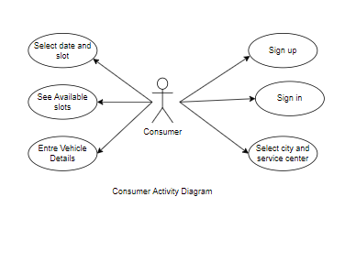
Use Case diagram for Consumers Module

Slide 8
Service Center Module
After successful registration and authentication from Admin , the service centre can
add servicing slots according to the date.
The service centre can edit his registration details.
Can delete bookings.
Can add service plans.
Can update servicing slots.
Will show invoice

Slide 9
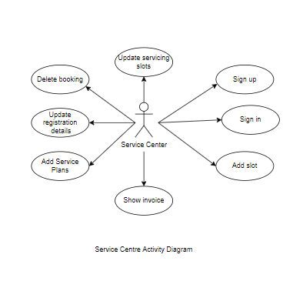
Use Case diagram for Service Centre

Slide 10
Admin Module
The Admin can
Sign in and Sign up
Add service centre according to cities.

Slide 11
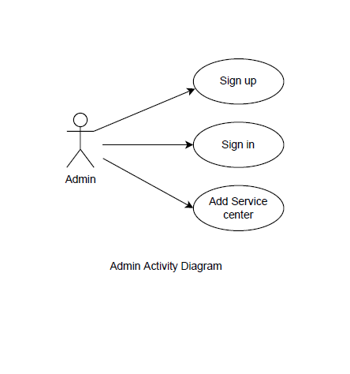
Use Case diagram for Admin

Slide 12
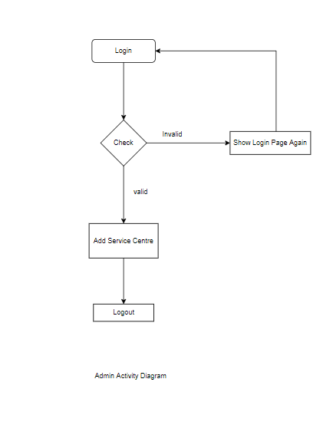
Activity Diagram : Admin

Slide 13
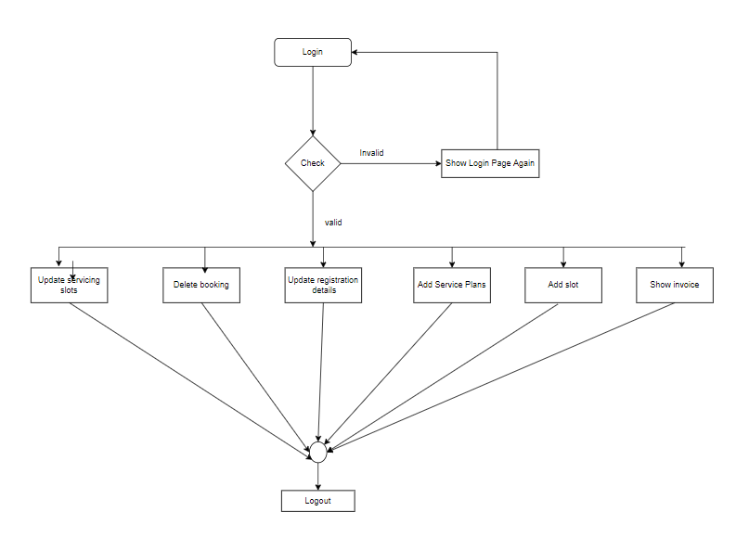
Activity Diagram : Service Centre

Slide 14
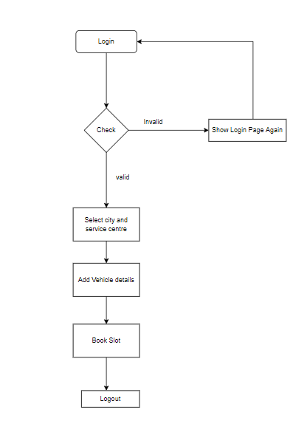
Activity Diagram : Consumer

Slide 15
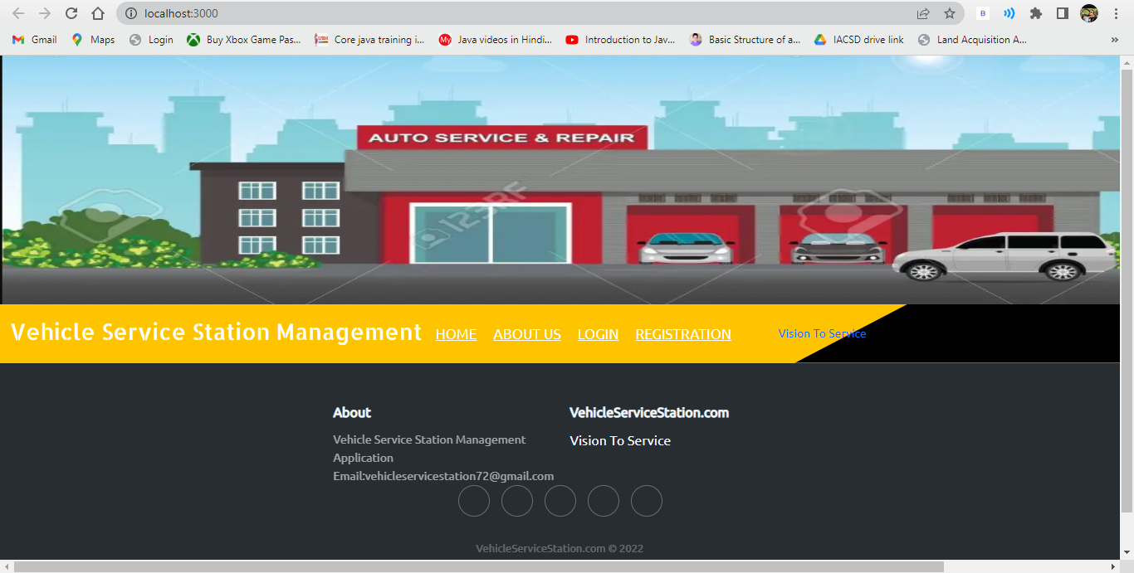
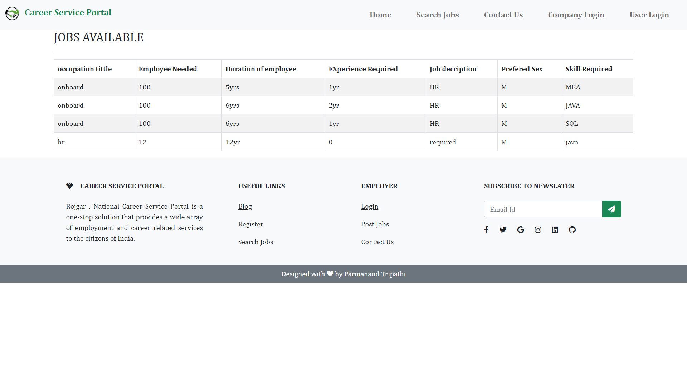
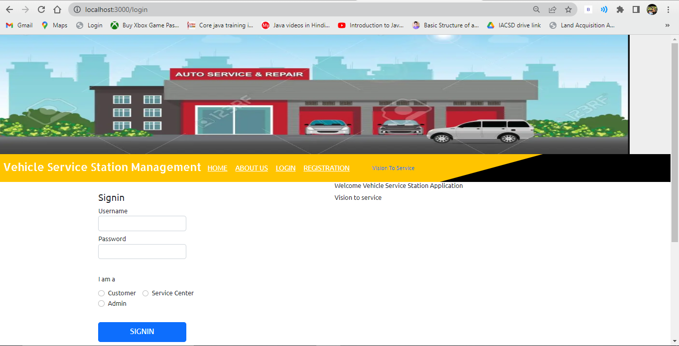

Slide 16
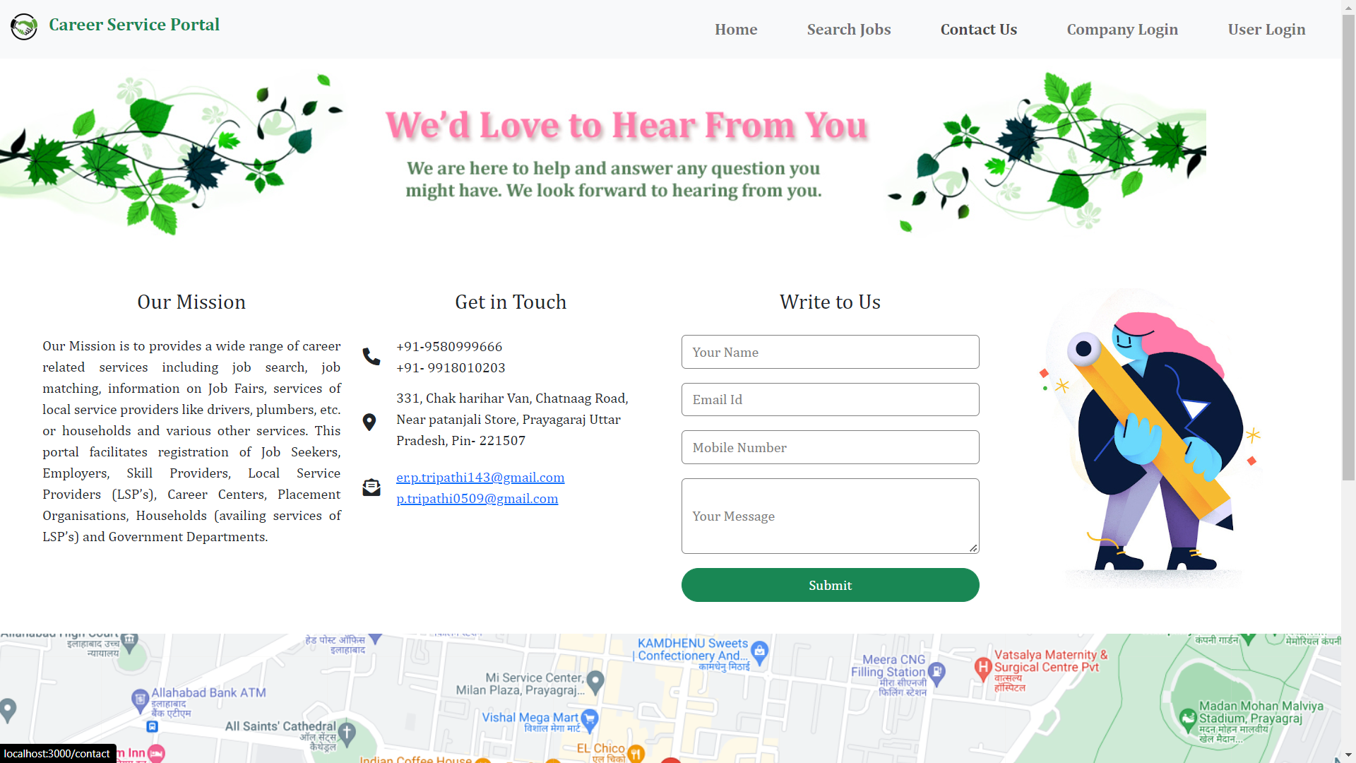

Slide 17
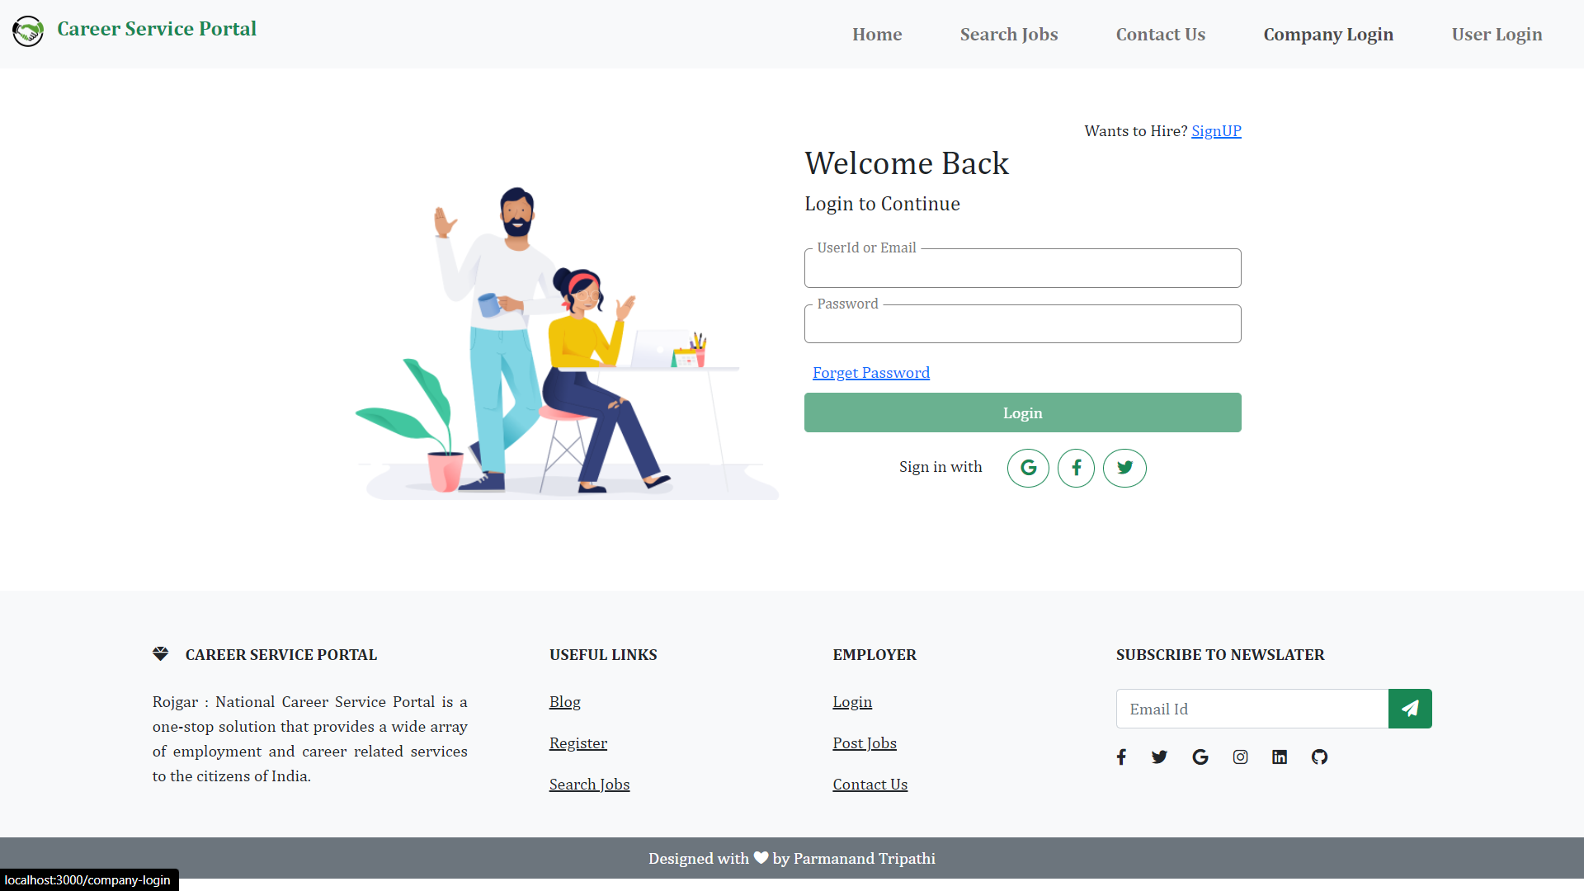
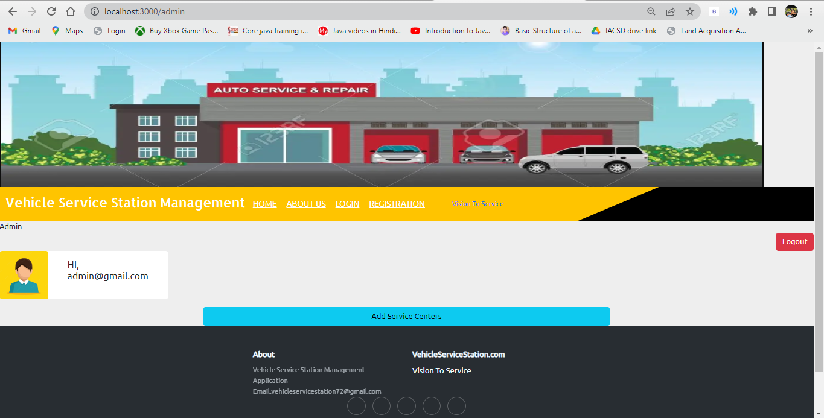

Slide 18
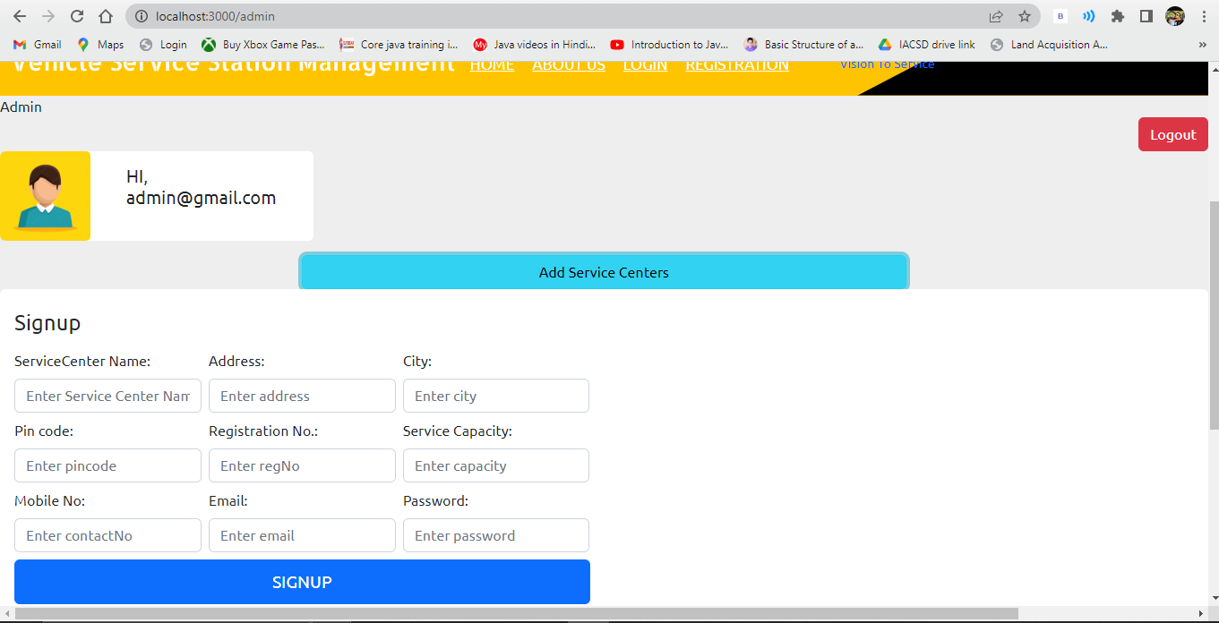
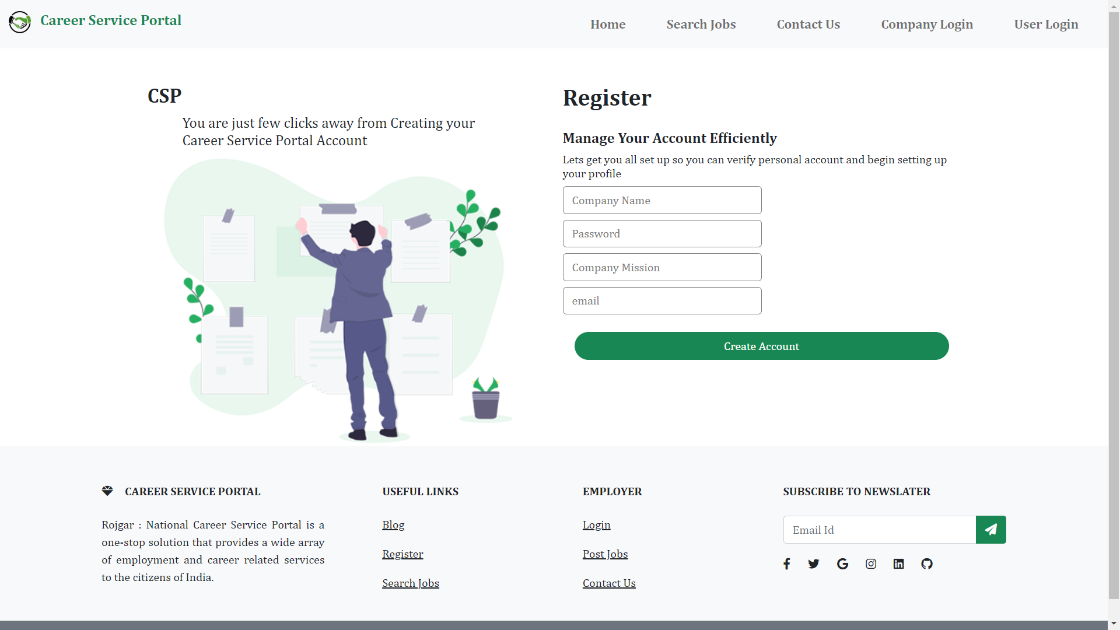

Slide 19
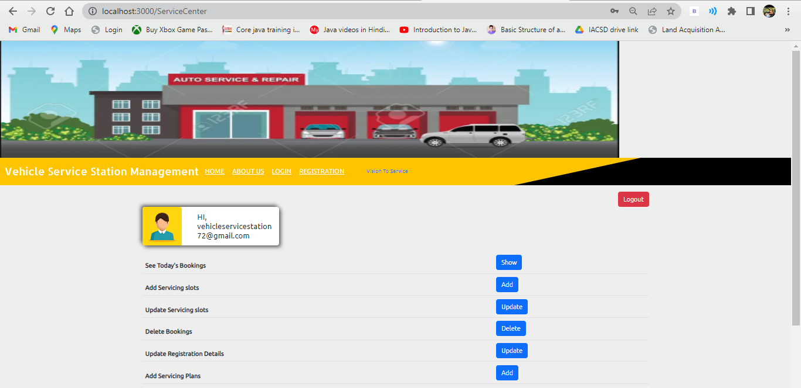
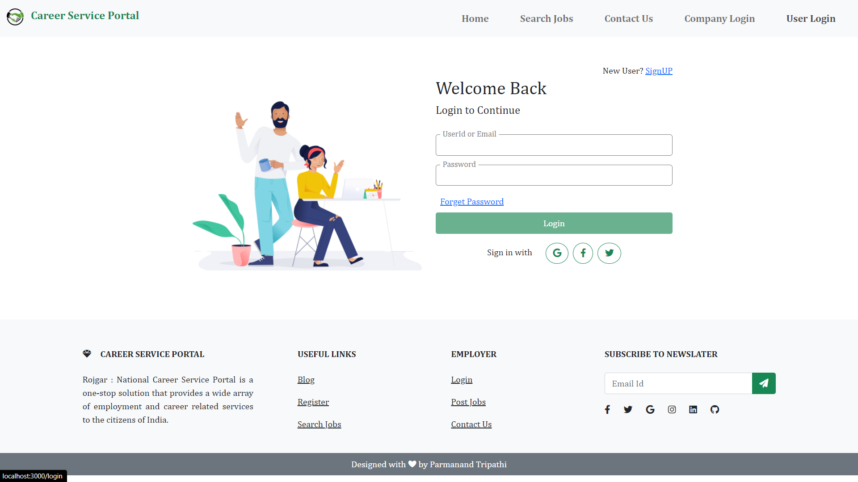

Slide 20
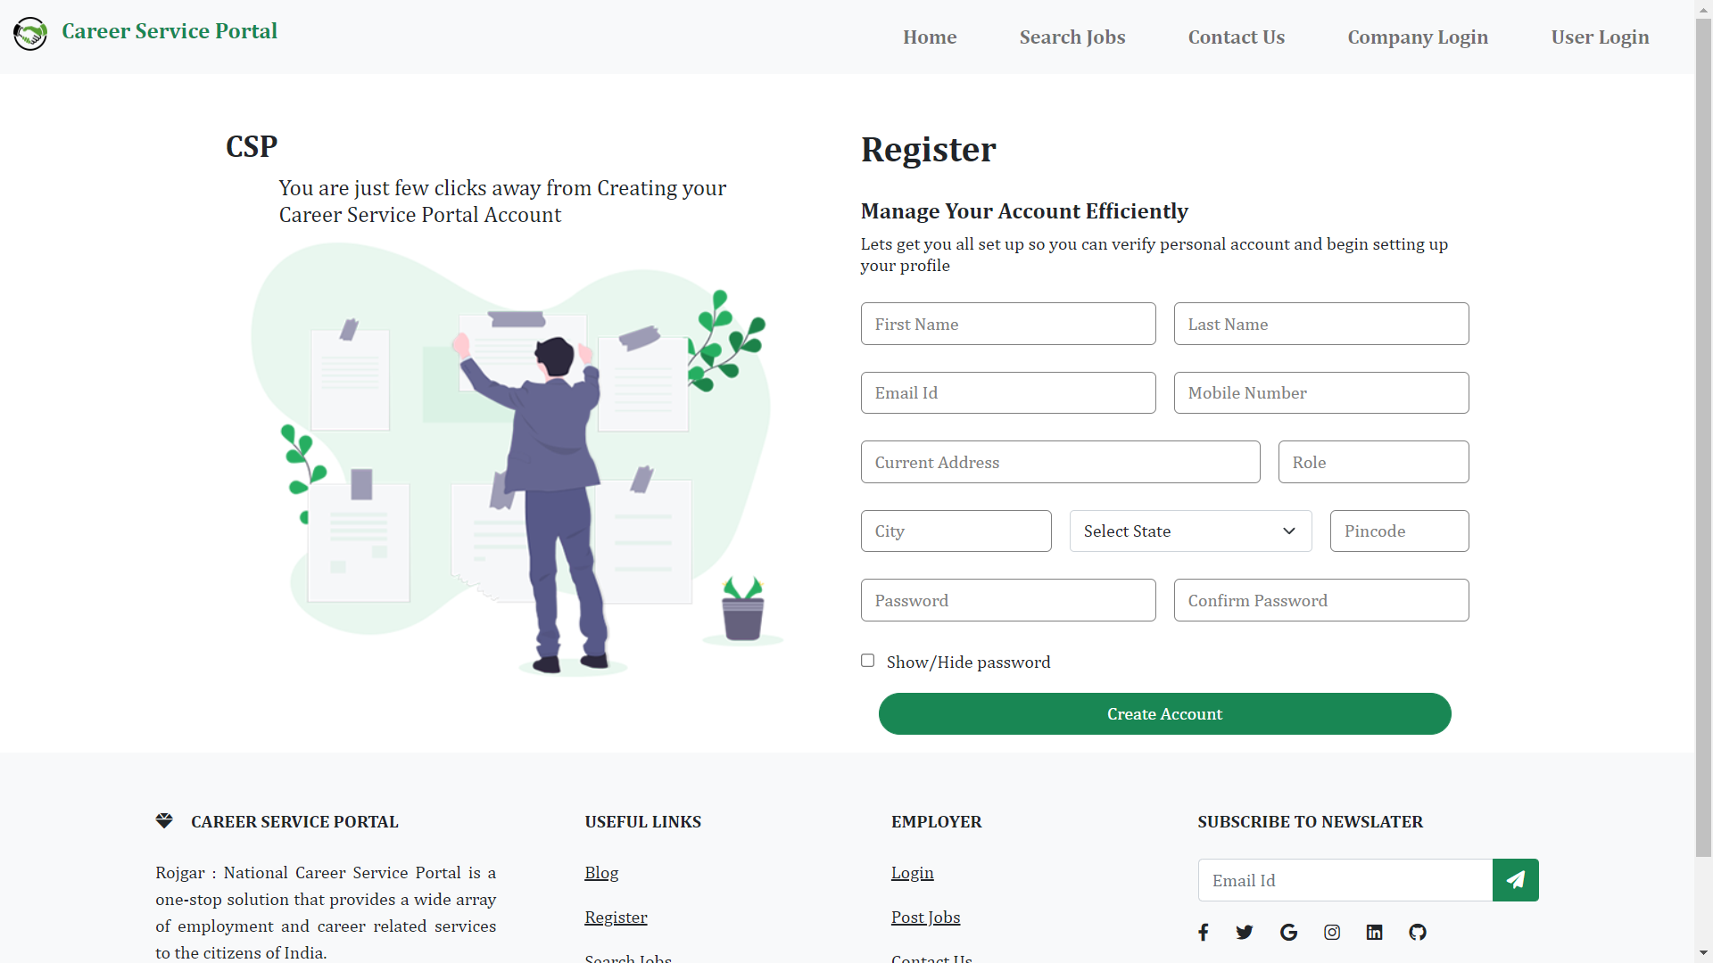
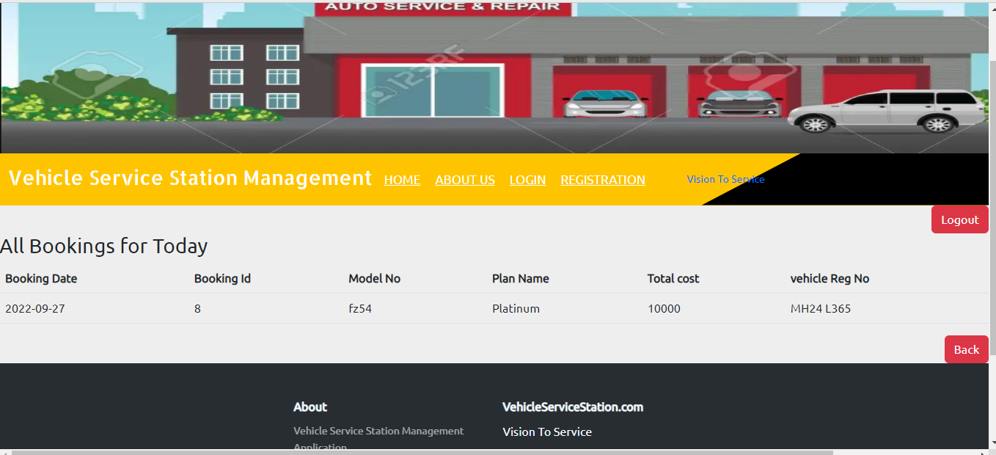

Slide 21
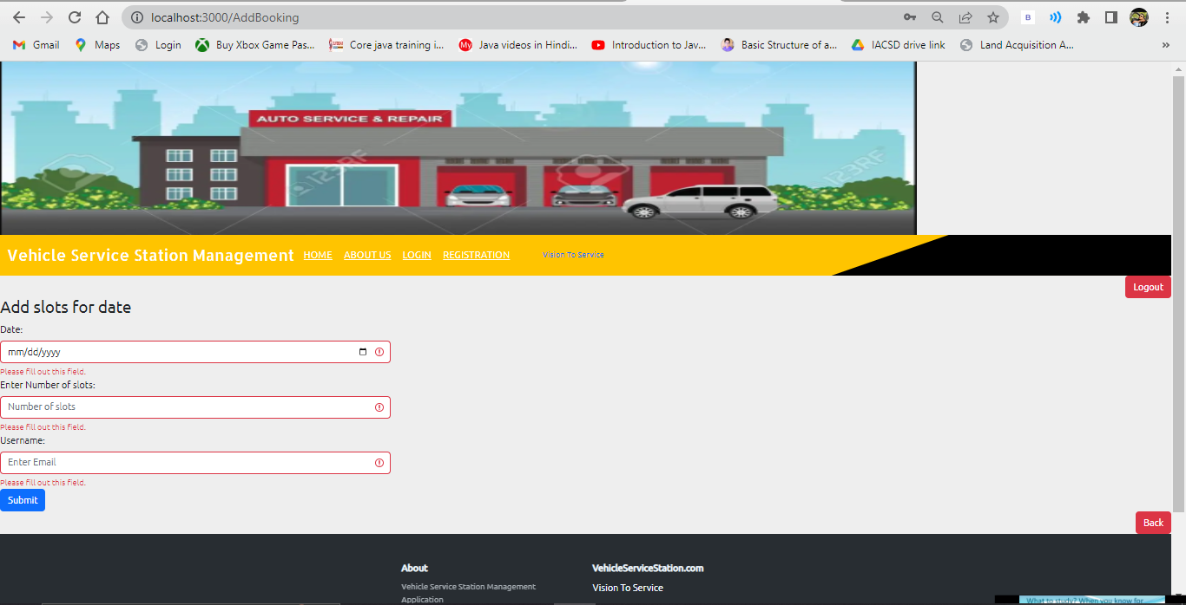
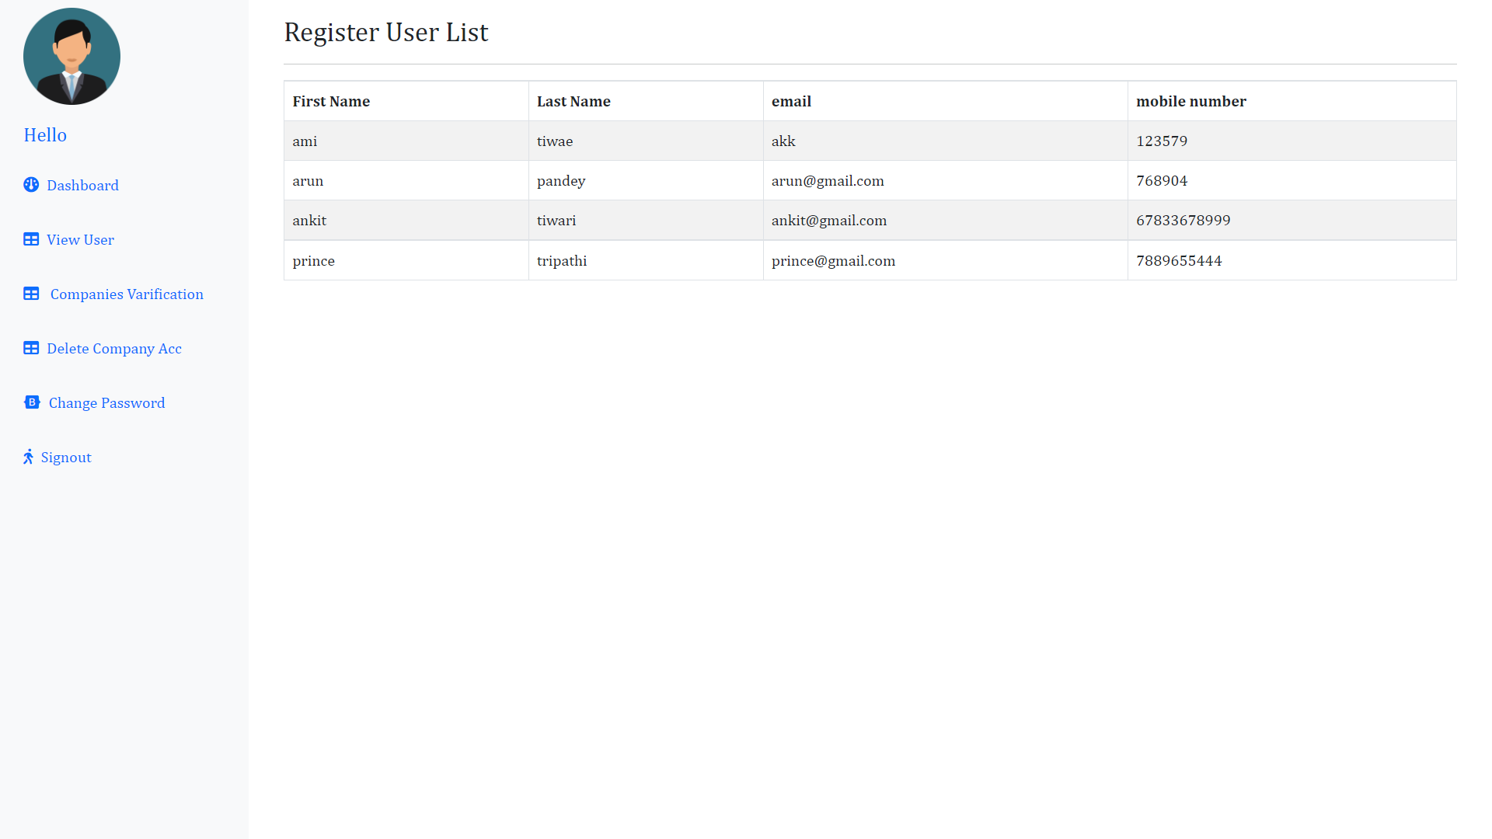

Slide 22
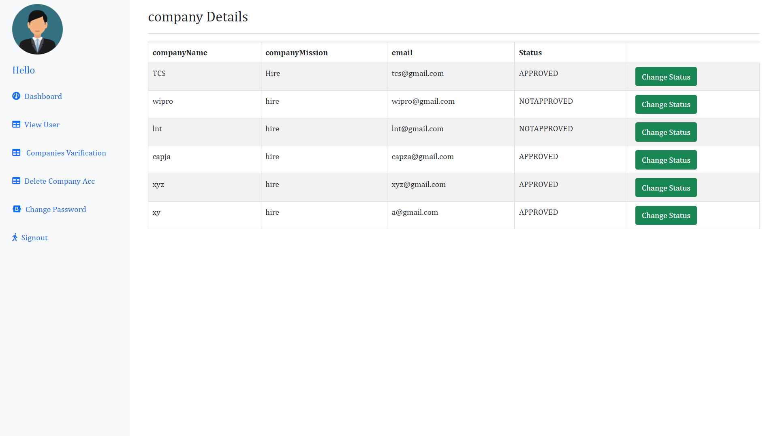


Slide 23
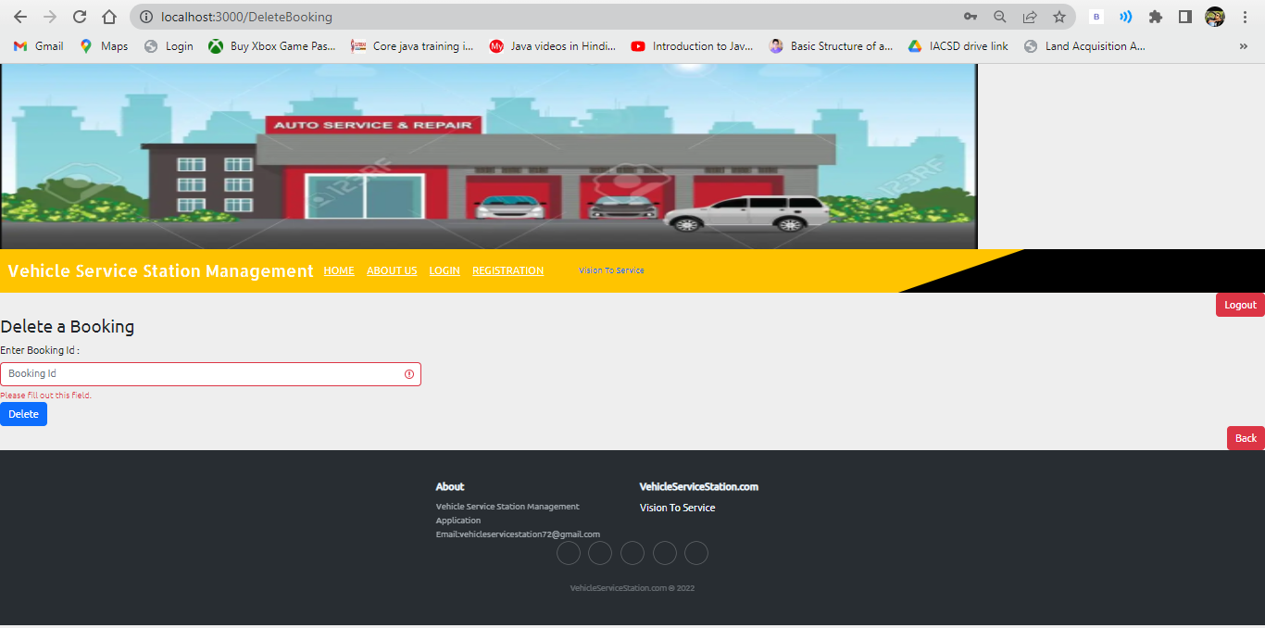
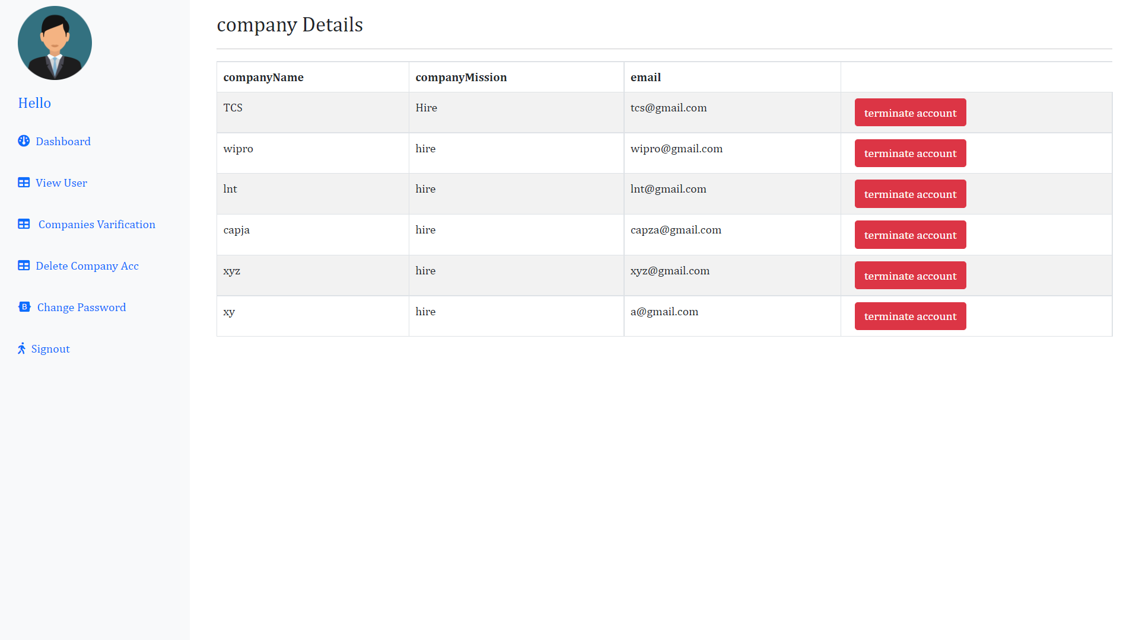

Slide 24
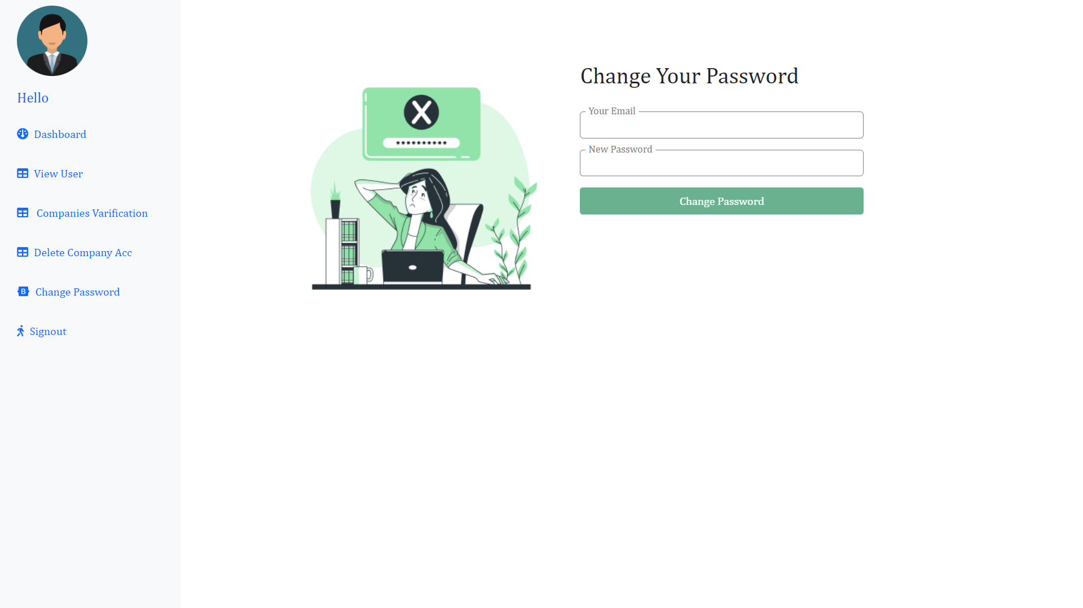
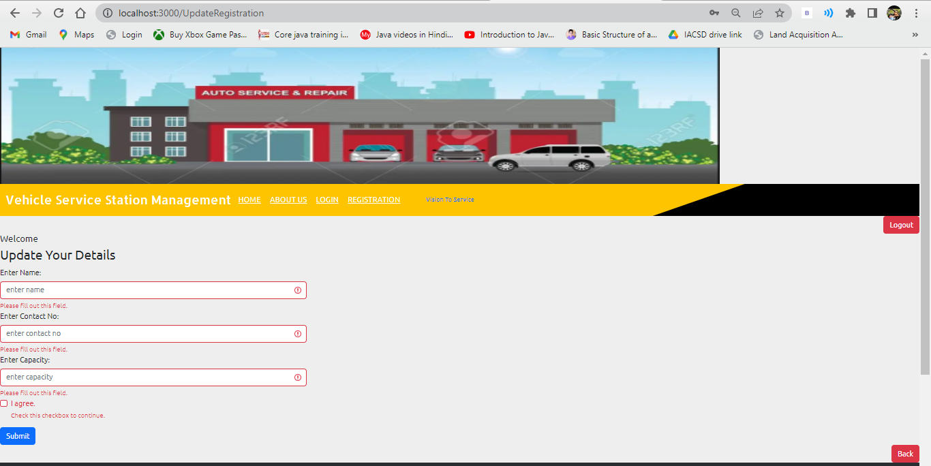

Slide 25
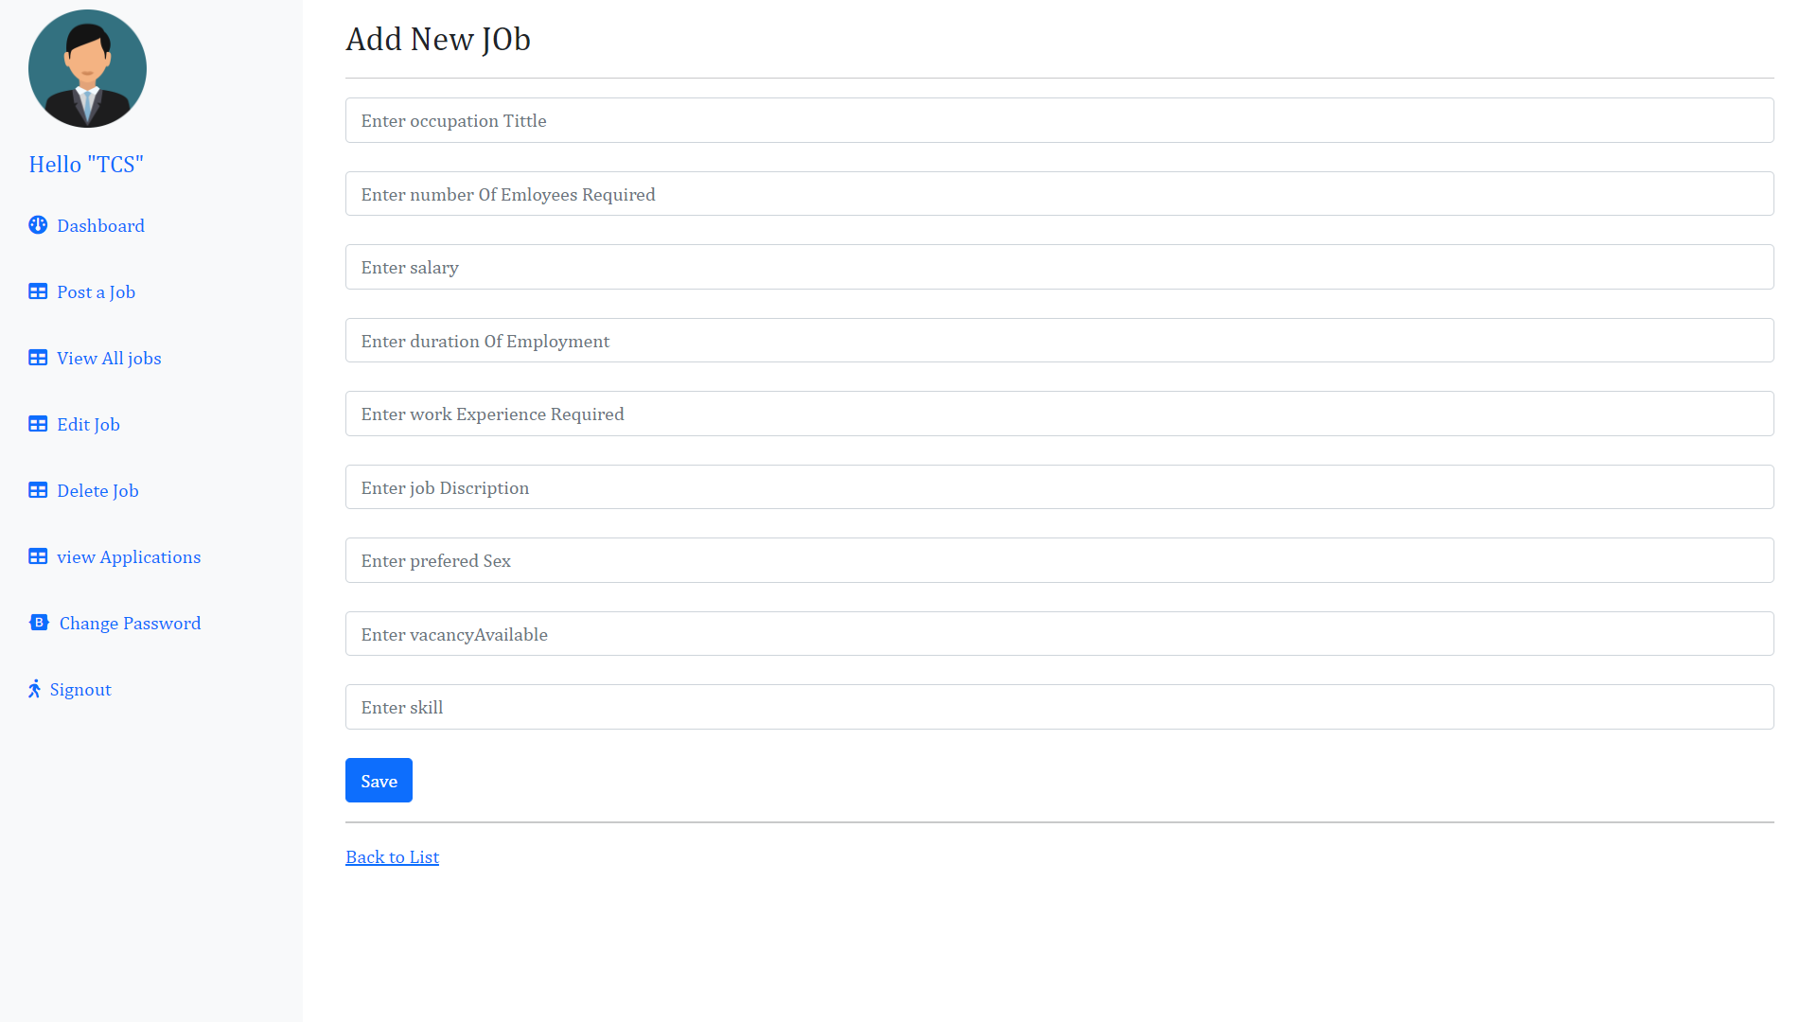
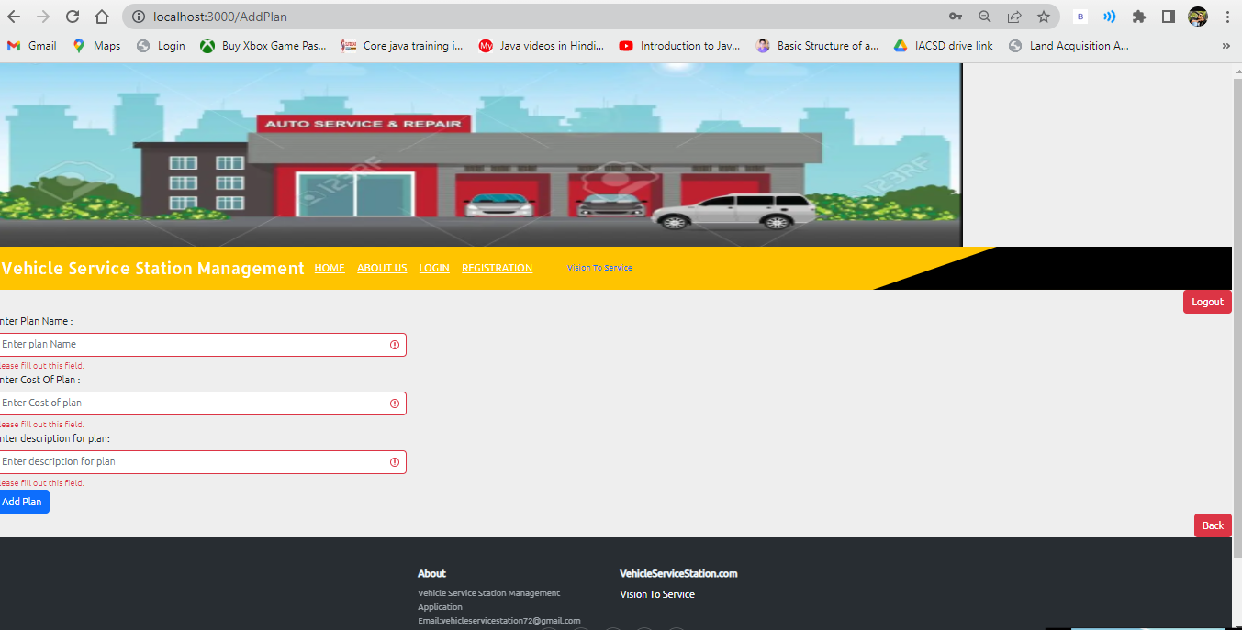

Slide 26
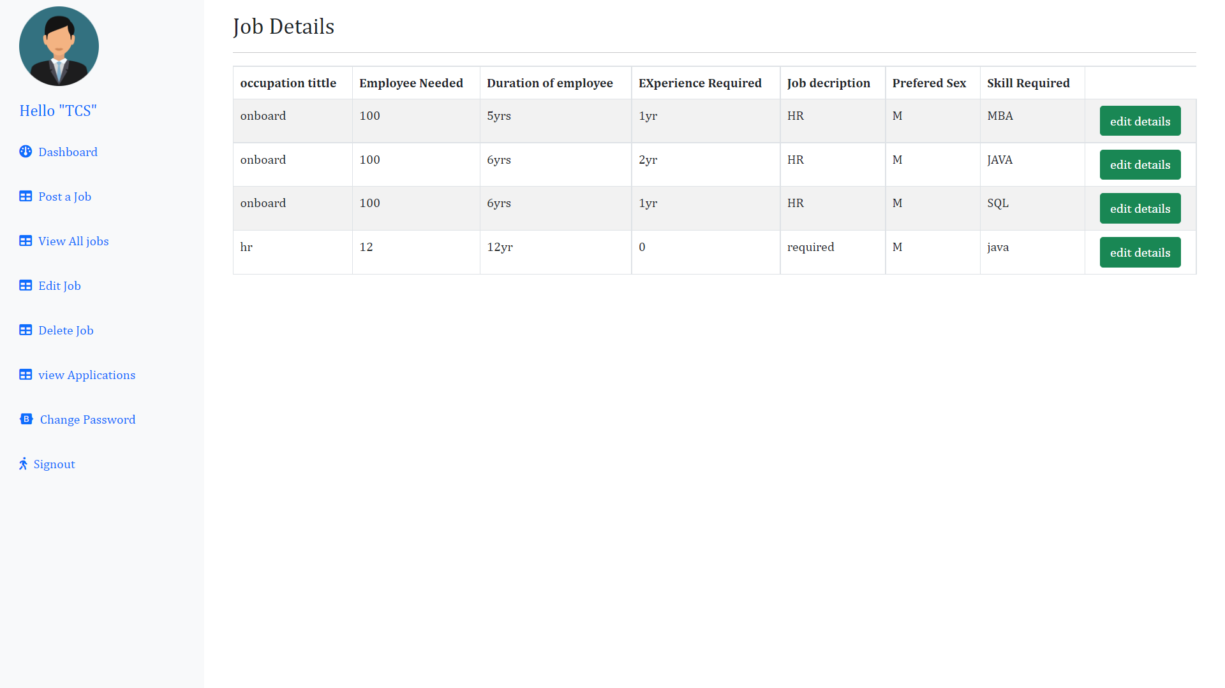
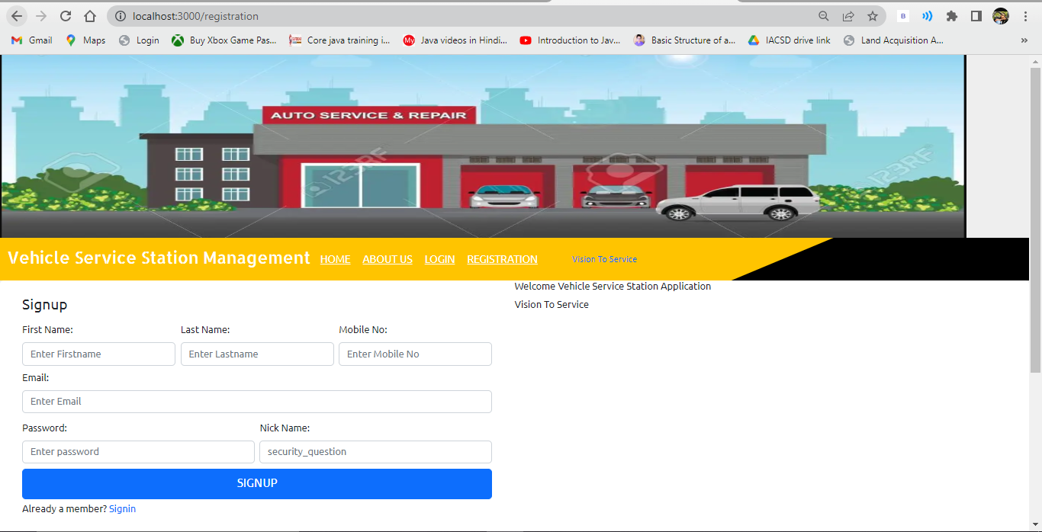

Slide 27
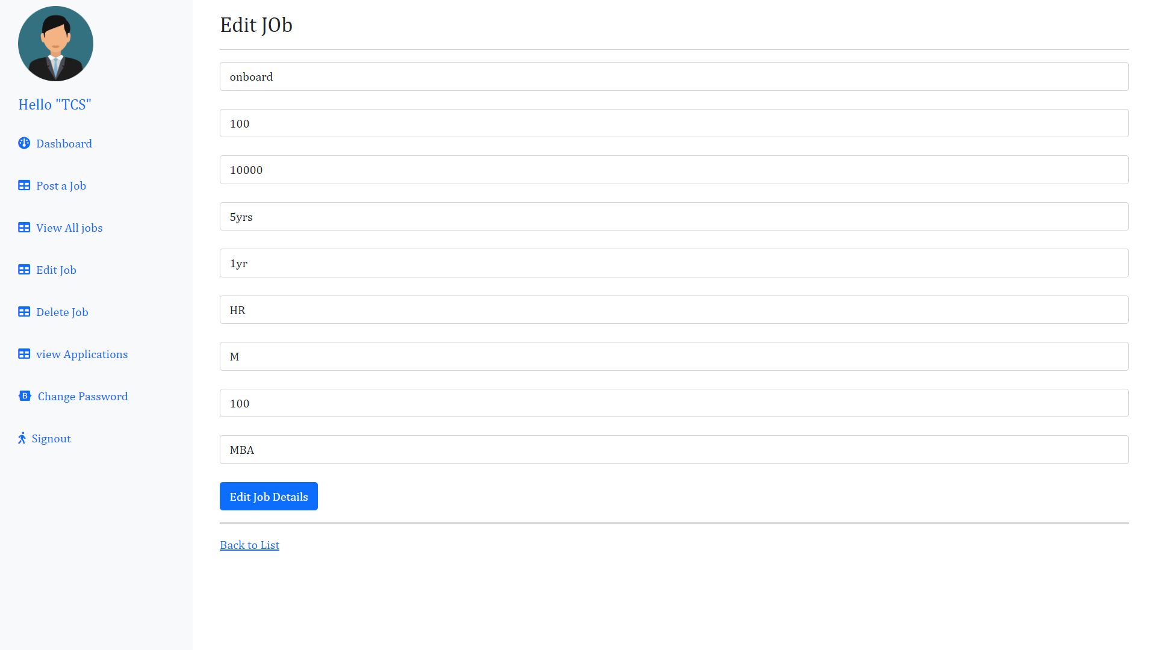
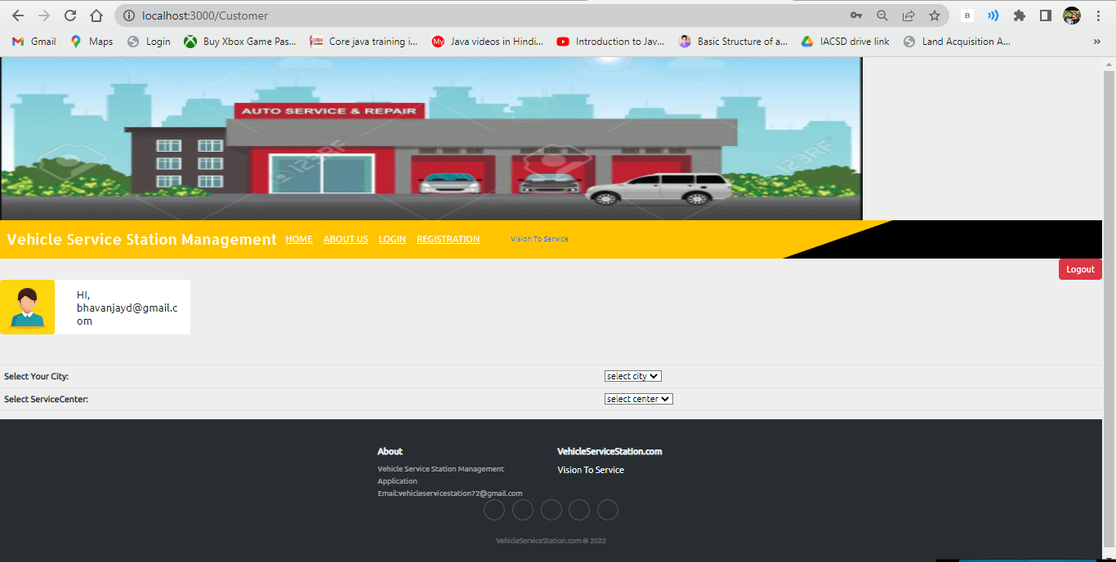

Slide 28
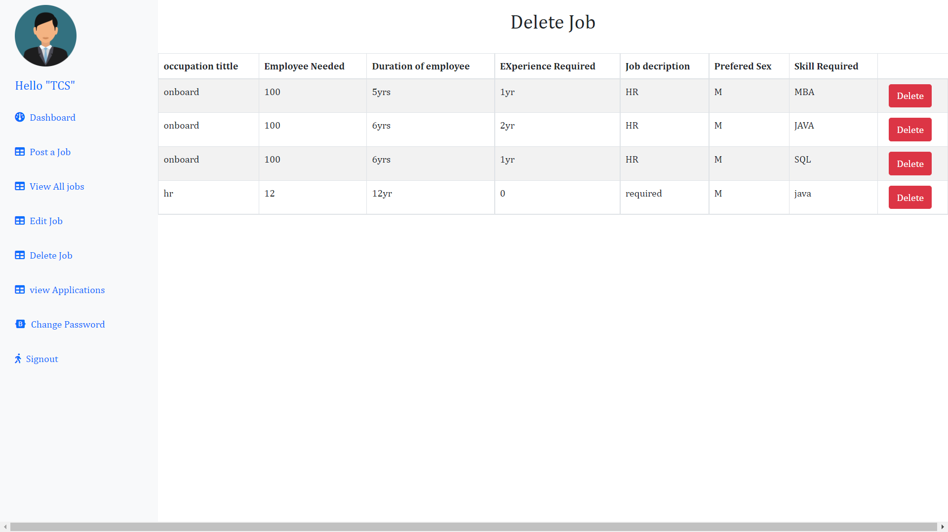
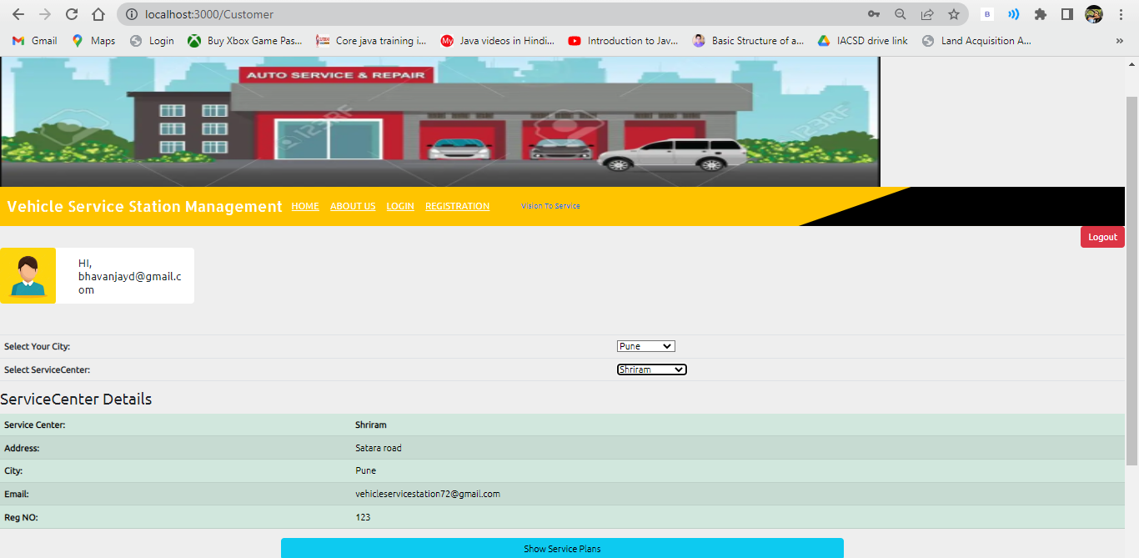

Slide 29
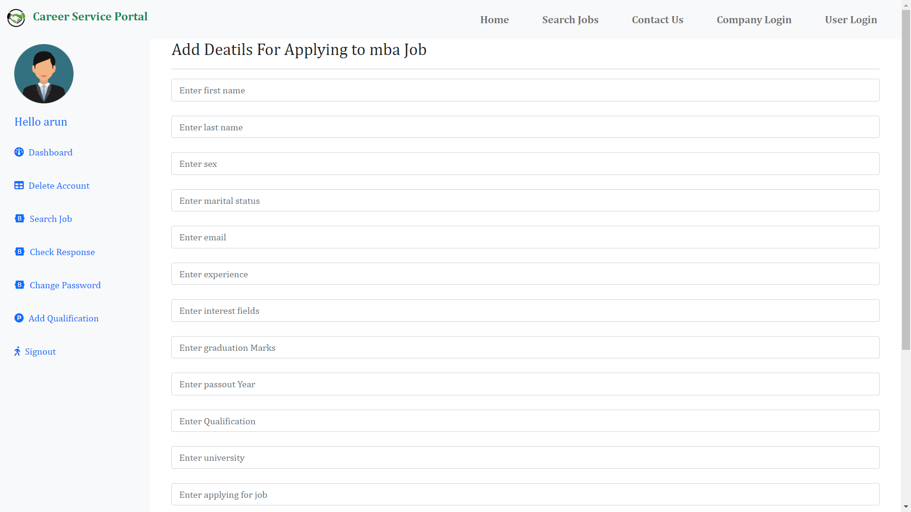
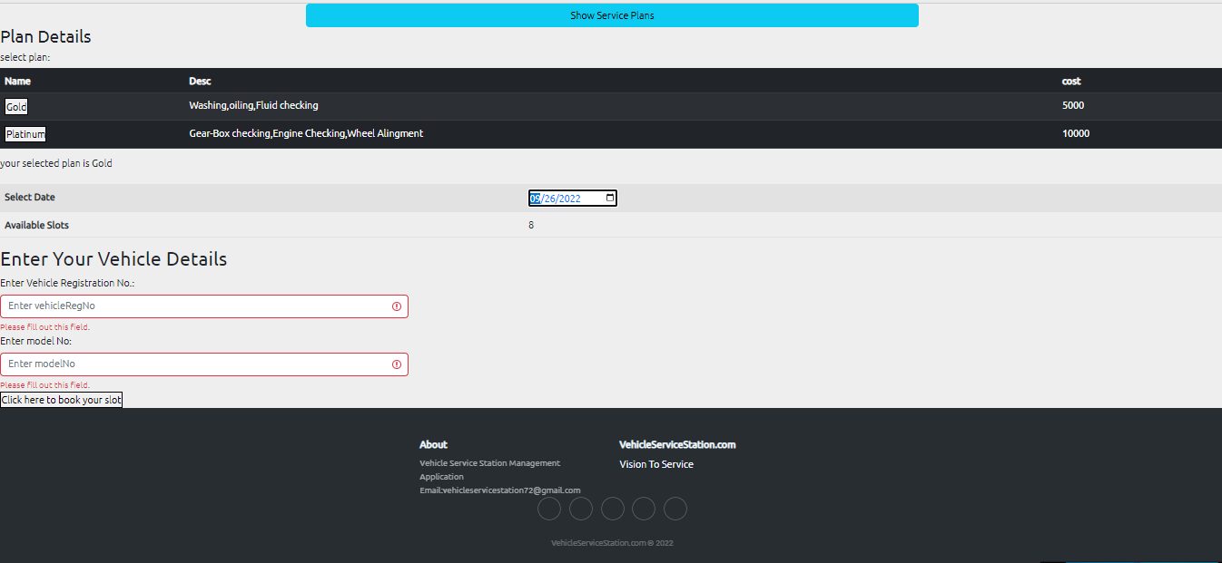

Slide 30
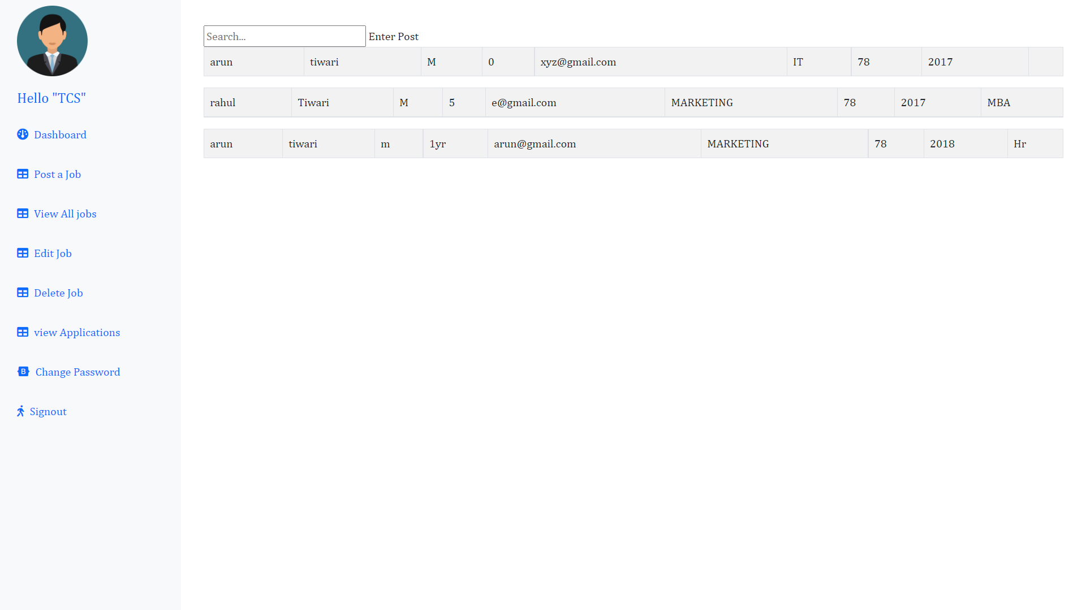
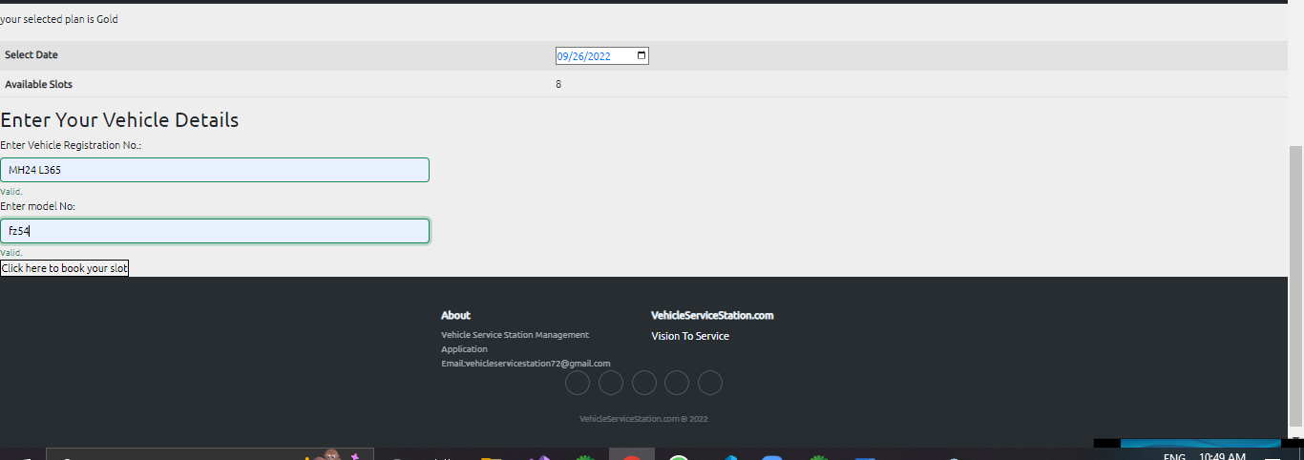

Slide 31
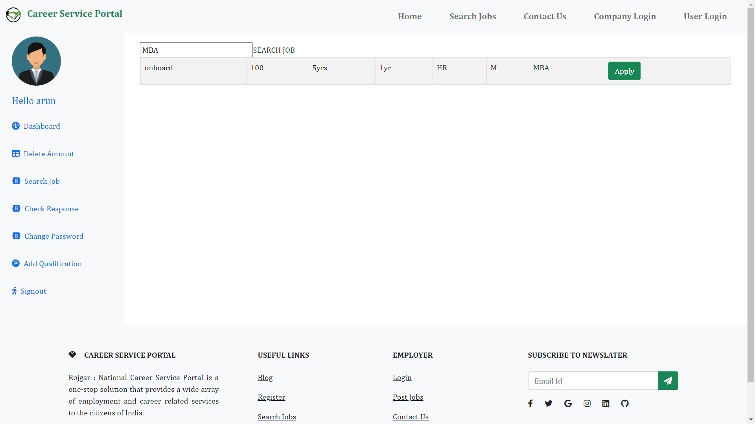
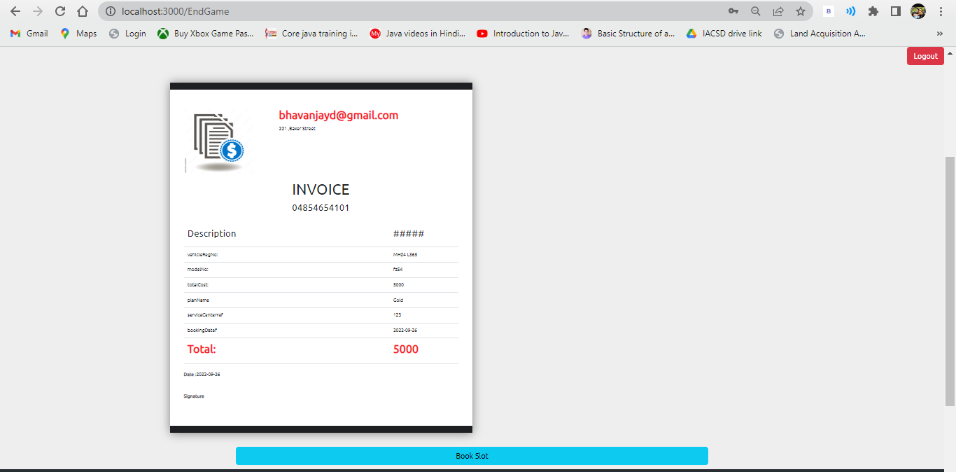

Slide 32
